Slide 1

Safe Exploration in Continuous Action Spaces
Dalal, G., Dvijotham, K., Vecerík, M., Hester, T., Paduraru, C., & Tassa, Y.
Presenter: Collin Avidano

Slide 2
Prior Works and Motivation

Slide 3
Prior Work
Constrained policy optimization (Achiam et al., 2017)
Proofs on safety were probabilistic (type II)
Safe model-based reinforcement learning with stability guarantees (Berkenkamp et al., 2017)
To prove safety required prior knowledge of system
Optlayer-practical constrained optimization for deep reinforcement learning in the real world. (Pham et al., 2017)
Optlayer is very similar to the work being presented as it is considered the safety task as an action correction formulation on a state wise basis
However…
It relied on a very computationally expensive in-graph QP solver for updates
It required prior knowledge of system
Notes:
Constrained policy optimization (Achiam et al., 2017)
Proofs on safety were probabilistic (type II)
Safe model-based reinforcement learning with stability guarantees (Berkenkamp et al., 2017)
To prove safety required prior knowledge of system
Optlayer-practical constrained optimization for deep reinforcement learning in the real world. (Pham et al., 2017)
Optlayer is very similar to the work being presented as it is considered the safety task as an action correction formulation on a state wise basis
However…
It relied on a very computationally expensive in-graph QP solver for updates
It required prior knowledge of system

Slide 4
Motivation
Zero constraint violations (type III, hard constraints)
Paper restricts this to PHYSICAL PROBLEMS (can be described with a deterministic transition function)
Be able to train on data that was logged from various sources (remove need for behavior-policy policy)
Be able to be pretrained so it can immediately enforce constraints when deployed
Does not require prior or expert knowledge of specific system (system params)
Implement as a safety layer that can be applied to any continuous control algorithm (RL or traditional continuous controls)
Safety layer is differentiable
Achieve above with a more simple implementation than Optlayer
Notes:
Zero constraint violations (type III, hard constraints)
Paper restricts this to PHYSICAL PROBLEMS (can be described with a deterministic transition function)
Basically does not include problems like the stock problem where the model for transition is acquired from data or is deterministic
Be able to train on data that was logged from various sources (remove need for behavior-policy policy)
Be able to be pretrained so it can immediately enforce constraints when deployed
Does not require prior or expert knowledge of specific system (system params)
Implement as a safety layer that can be applied to any continuous control algorithm (RL or traditional continuous controls)
Achieve above with a more simple implementation than Optlayer

Slide 5
Method

Slide 6
Overview
Composing a safety layer on top of an original policy generator who is unaware of constraints (shielding)
Formulate correction similar to a cmdp but where observed safety signals should be kept bounded
2 primary parts:
Linear Safety-Signal Model
Safety Layer via Analytical Optimization
Notes:
Composing a safety layer on top of an original policy generator who is unaware of constraints (shielding)
Formulate correction similar to a cmdp but where observed safety signals should be kept bounded
2 primary parts:
Linear Safety-Signal Model
Safety Layer via Analytical Optimization

Slide 7




Safety Signals
Immediate constraints
Actual boundary at which we should start corrections
Safety signals
Per state observations of the immediate constraint values
One per constraint
In the case of robot navigation this would be the distance of the robot to an obstacle
What we want is to know is “will the effect of a particular action lead to a state with a safety signal that violates a constraint constant”
Under deterministic transitions
Notes:
Immediate constraints
Actual boundary at which we should start corrections
Safety signals
Per state observations of the immediate constraint values
One per constraint
In the case of robot navigation this would be the distance of the robot to an obstacle
What we want is to know is “will the effect of a particular action lead to a state with a safety signal that violates a constraint constant”
Under deterministic transitions

Slide 8
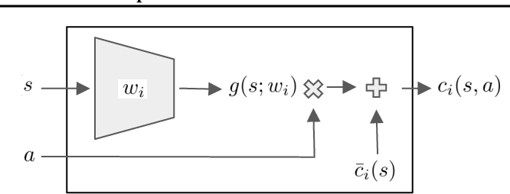


Linear Safety-Signal Model
Rather than directly learn t the paper instead learns a linear approximator through g
This model is a first order approximation of with respect to a
Can be seen as learning the dynamics of the system but only in how they affect IMMEDIATELY affect the safety signals (even for actions on force)
The effect of the action on each safety signal is approximated with its own NN
Notes:
Rather than plugging in both state and action to a neural net and getting out the value of c_i(s,a) the authors found
This can be seen as learning learning how the dynamics of the system when taking a particular action affect the safety signal.
Which if the safety signal is just the distance to an obstacle then it is a form of dynamics.

Slide 9

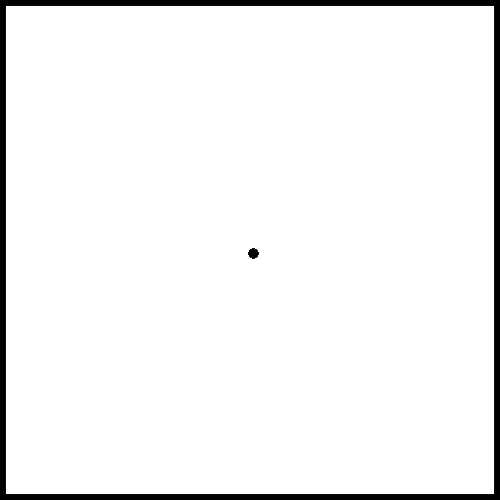


Quiz 1
Given that our actions are a commanded velocity such that we are moving left
We start at the middle of a square with directions for individual constraints given on the right. Our safety signals are defined as the distance to the boundary they represent. Filling in for values:
Given this setup what constraint should have the g estimator:
C3
C4
C2
C1
Notes:
Should be c2 as the distance to c2 is increasing

Slide 10
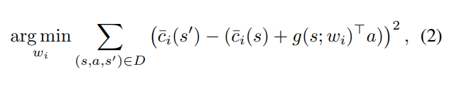
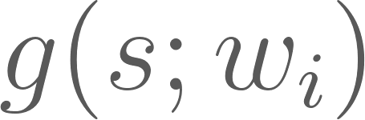

Training the Linear Safety-Signal Model
Training is performed once per task before RL training
It takes the form of a standard supervised learning problem using MSE loss
is assumed to be included in s
In the case of obstacle avoidance this could be derived per constraint from s (position)
Notes:
Training the linear safety models g is performed once per task before RL training
It takes the form of a standard supervised learning problem using MSE loss
C bar (s) is assumed to be included in s
In the case of obstacle avoidance this could be derived per constraint from s (position)

Slide 11
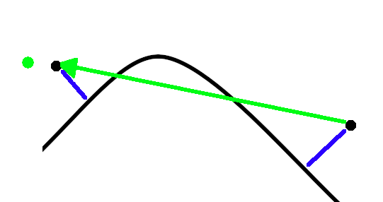
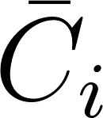
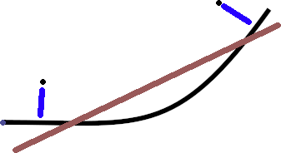
Discussion 1
What are some pros and cons of using linear models to estimate our next state safety signals?
(Pro) Easier to calculate
(Pro) Holds up over linear constraints
(Con) Will only learn a linear model for a nonlinear constraint
(Con) Fails over long time horizons especially with nonlinear constraints
Long rollout
Goal
Training
Linear model fit to data
Path to goal
Robot position
Distance to obs.
Notes:
(Pro) Easier to calculate
(Pro) Holds up over linear constraints
(Con) Will only learn a linear model for a nonlinear constraint
(Con) Fails over long time horizons especially with nonlinear constraints

Slide 12
Discussion 2
What are some issues we might have to deal with when using real world log data to train our linear safety constraints?
We have define obstacles by hand
Unlikely that the original logs have the exact definition of safety signal you do for obstacles
Real world logs may not give distance to obstacles at all (may only give position)
Notes:
Unlikely that the original logs has the exact def of the safety signals you have and same def for obstacles
(authors made the assumption it would be)
So may require preprocessing to fit real world signals to your constraints
Real world logs may not give distance to obstacles at all (may only give position) even if the system is equipped with a lidar or other range finding device
So you would have to have a map separately and define your constraints on that map and preprocess for safety signals to each part of that environment
Authors note you can merge constraints into a single safety signal but noted that it was a point for future work to determine how far model these with a single linear g network could really go
As we will see later on the experiments the authors ran this on only had 4 to 6 constraints in a rather simple environment

Slide 13
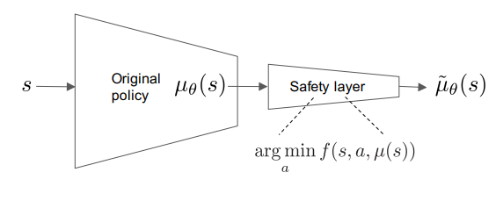

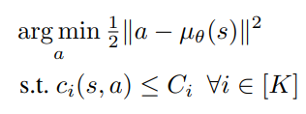
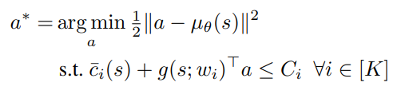
Safety Layer via Analytical Optimization
Safety layer is composed on top of original policy
is the action generated by the original policy
We want to change original action as little as possible while still satisfying constraints
We estimate the resulting safety signal after taking an action using our linear estimator
Notes:
Safety layer is composed on top of original policy
$$\mu_{\theta} (s)$$ is the action generated by the original policy
We want to change original action as little as possible while still satisfying constraints to produce
So if none the constraints are violated by the original action then we get the minimal difference by simply using the original action (nothing changes)
Remember we are assuming this layer is isolated from our policy system and does not have access to transition info so knowing c(s,a) is not going to be something we know
To solve this we apply our estimator of the constraint signal times the given action(acting as a linear estimator of an actions effect on the safety signal)

Slide 14
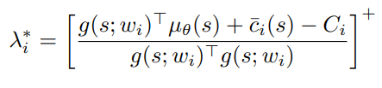





Safety Layer via Analytical Optimization
Perturb the action as little as possible while still satisfying constraints using lagrangian optimization
Under some assumptions: corrected action is a projection of the original action to the plane with slope and intercept
As for which constraint to consider all should be 0 except for one under authors given assumptions
Notes:
Perturb the action as little as possible while still satisfying constraints using lagrangian optimization
Under some assumptions: corrected action is a projection of the original action to the plane with slope g and intercept cbar_i(s) - C_i
Authors note there are multiple ways to solve this optimization
However they propose the relatively realistic assumption that no more than one constraint is active at a time
Under that assumption you can simplify this to the following idea
If we assume that there is only one constraint that is closest to being violated we can treat this as a projection of the original action to the play with slope bar c_i(s) - C_i
As for which constraint to consider all should be 0 except for one under authors given assumptions
NOTE THIS IS IN OPPOSITION TO MEASURES LIKE TRPO AND ITS KL DIVERGENCE

Slide 15
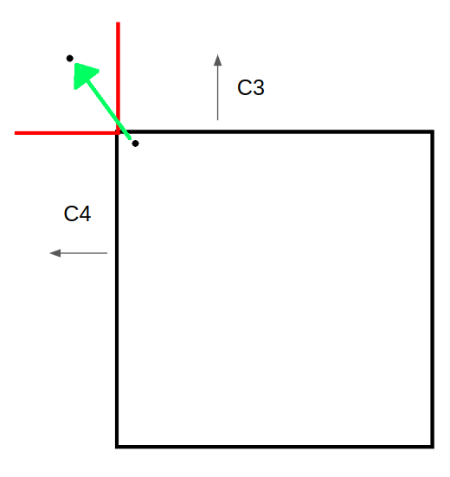
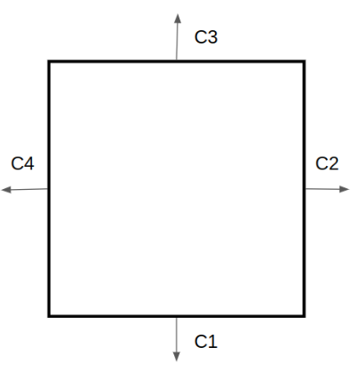
Quiz 2
Given our earlier constraint setup, what is a situation in which the assumption that only one constraint will be violated at a time not hold? (Give a starting position and end position after an action)
Notes:
SHOULD BE A SQUARE STARTING AT THE CORNER AND GOING OUT

Slide 16

Safety Layer via Analytical Optimization
Components of a that affect this constraint
Slack on boundary
Always >=0
Magnitude of correction in direction of -g
Final Action
Notes:
Authors note there are multiple ways to solve this optimization
However they propose the relatively realistic assumption that no more than one constraint is active at a time (tested at corners of the box and one is always dominating so its fine)
Under that assumption you can simplify this to the following idea: The corrected action given by the safety layer will be the action that leads to the state ON THE CONSTRAINT BOUNDARY at a projection from the violating state induced by the original action
NOTE THIS IS IN OPPOSITION TO MEASURES LIKE TRPO AND ITS KL DIVERGENCE

Slide 17

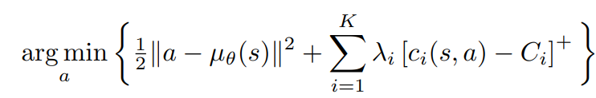
Alternative Loss
Below is an alternative unconstrained surrogate objective function using a nn instead of a linear approximation to
The authors note that the issues with this approach include
The need to run gradient descent to optimize the below and find the corrective action (remember g was a vector used to find the corrective action whereas c is scalar here)
Has different orders of magnitudes for each action which leads to numerical issues with the gradient for this value
Notes:
We didnt need to run gradient descent on the other because c_i(s,a) here will just be a scalar, We wont have a vector that tells us how to project to the constraint boundary

Slide 18
Experiments

Slide 19


Experiments
To validate the usage of the safety layer in physics based use cases the authors ran 4 experiments in Mujoco comparing DDPG, DDPG with reward shaping, and DDPG composed with the proposed safety layer
2 in ball env and 2 in spaceship env
All of these have the constraints as lower bounds on the object's distance to a boundary (obstacles)
So the immediate constraints by definition should be 0=
But authors set constraint constants to be some small distance as to allow the safety layer to take effect
Notes:
To validate the usage of the safety layer in physics based use cases the authors ran 4 experiments in Mujoco (ball and spaceship are made by the authors)
Ball is velocity controlled(which authors do to show this method works for systems governed by 1st order differential equations)
Spaceship is force controlled(which authors do to show this method works for systems governed by 2nd order differential equations which include robot arms and cooling systems mentioned earlier)

Slide 20

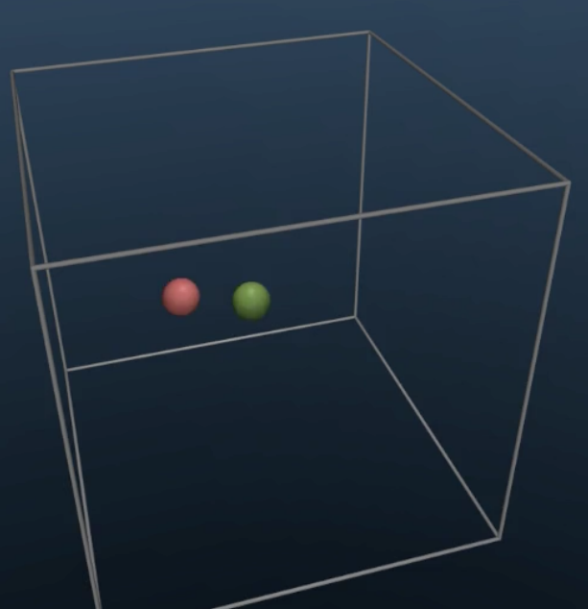
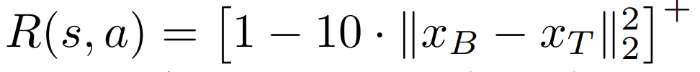
Ball Environment
Has a 1d and 3d setup
Goal is to keep the the agent ball (green) as close to the target ball(red) as possible
Agent ball is is velocity controlled
Targets position is given as a noisy estimate
Reward falls off very quickly when not right on top of the target
1d Ball Setup
3d Ball Setup

Slide 21
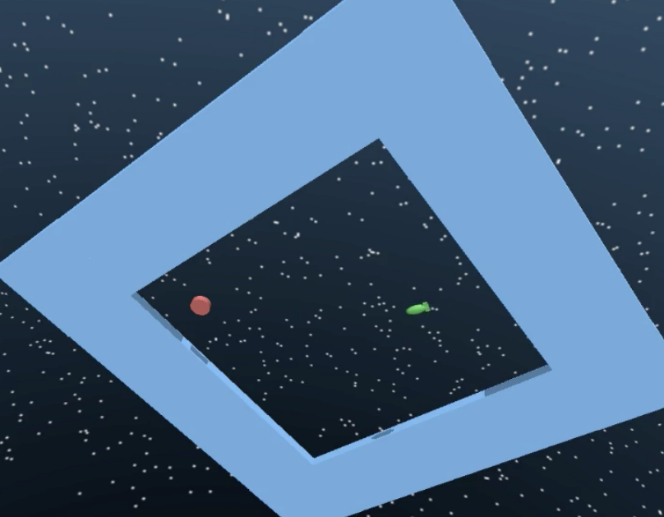
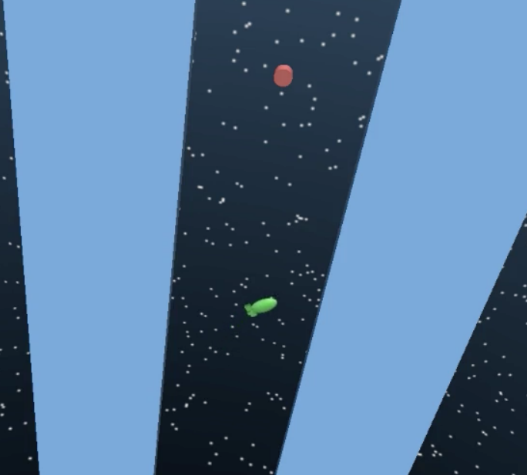
Spaceship Environment
Has an arena and a corridor setup
Goal is to navigate space ship(green) to red target position
Spaceship is force controlled
1000 points for reaching the target position and 0 elsewhere
Spaceship Arena Setup
Spaceship Corridor Setup

Slide 22
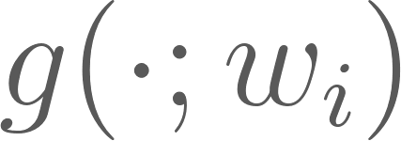
Safety Layer Implementation Details
Data set D generated from random policy for experiments training
Random promotes exploration which promotes linear safety models performance by exposing it to hazardous conditions
The safety signal model was pretrained for each of the tasks for each constraint individually using the data set D
In order to attain zero constraint violations the authors found that it sufficed to have the gradient estimator be a single layer NN with 10 neurons
Notes:
Other notes
Trained with adam optimizer
Low error for g not necessarily better but more random exploration is
Based on a hyper-parameter sweep for DDPG, for the actor and critic we use two-hidden-layer NNs of respective sizes (100, 100) and (500, 500).
The rest of the experiment parameters were taken to be as in (Lillicrap et al., 2015).

Slide 23
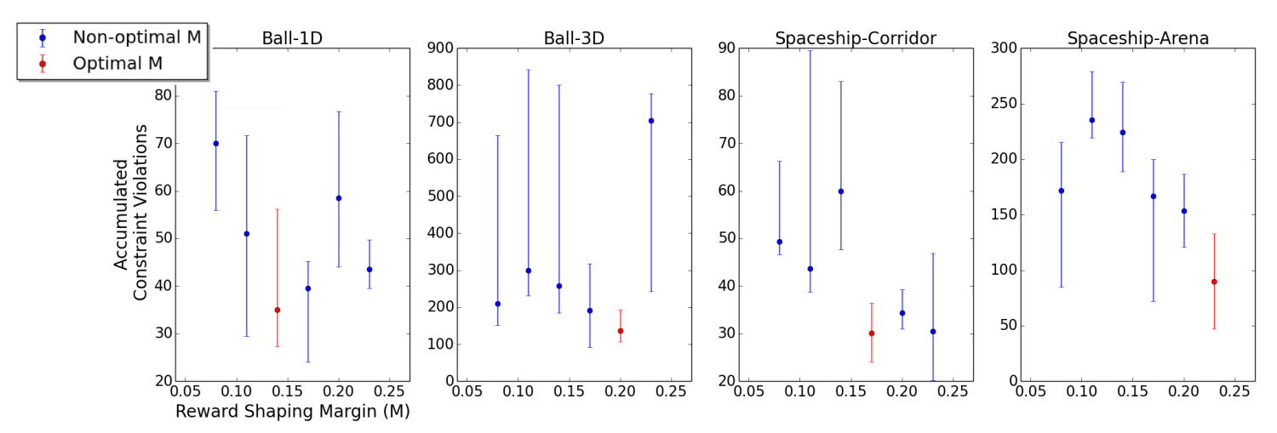
Reward Shaping Implementation
Reward outside of boundaries is -1 on ball and -1000 on spaceship
Allowed reward shaping a margin just like the safety layer (but tuned for lowest count of violations when training using shaping)

Slide 24
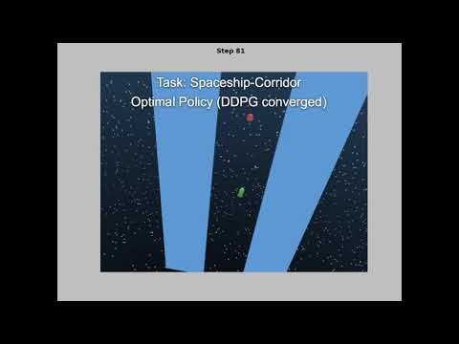
Experiments(video)
In the following videos of the authors experiments, the more red the ball is the larger the magnitude of the dominant lagrange multiplier
This gives us a visualization of how much the safety layer is correcting the original action

Slide 25
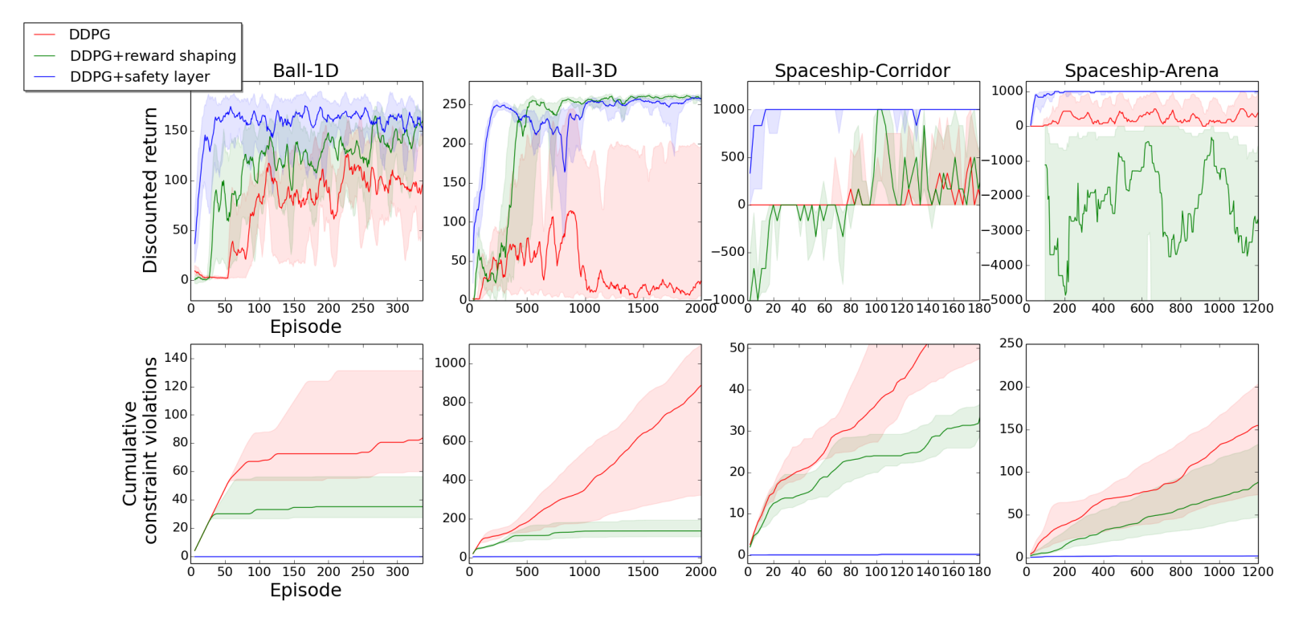
Results
Notes:
Margins are results for the upper and lower quantiles of 10 seeds
DDPG+safety layer not only achieved zero violations (blue line in bottom row) but also obtained the highest discounted reward and had the fastest convergence (Especially on the spaceship domain look at top right two diagrams)
DDPG+reward shaping converged faster than DDPG but with a lower discounted reward

Slide 26
Conclusion
The composed safety layer can be used on top of any continuous control mechanism
Provides a mechanism for shielding and action correction that is simple to implement and compute
Mechanism expedites convergence as tasks do not have to constantly reset (achieves zero constraint violations)
Can be trained from recorded data (provided some preprocessing)
Notes:
The expediting can best be explained as with reward shaping its oh you ran into a wall and now im going to tell you you messed up and just put you back at the start and try again vs im going to guided you away from the wall so you never have to restart.

